Slide 1
Next Point-of-Interest Recommendation for Cold-start Users with Spatial-temporal Meta-Learning
Advisor: Jia-Ling, Koh
Speaker: Hsiang-Hui Chou
Date: 2023/05/23
Source: IEEE-23

Slide 2
Outline
Introduction
Method
Experiment
Conclusion

Slide 3
Point-of-Interest(POI)
NTNU
Dorm
NTNU
Branch
(Bus stop)
NTNU
Heping campus
Shida Night
Market
NTNU
Dorm
9:00
(25.1, 121.3)
10:00
(25.2, 121.4)
10:30
(25.2, 121.7)
18:00
(25.2,121.6)
19:00
(25.1, 121.3)

Slide 4
Input
user set U = {u₁, u₂, …, u_{G}}
POIs = {l₁, l₂ , …, l_{p}} where l_{k} =<id_{k} , lon_{k} , lat_{k}>
ID, longitude, latitude
Trajectory of a user over time
S_{i} = {p₁, p₂ , …, p_{k}} where p_{j} = <u_{m} , l_{i} , t_{i}>
𝑝_{𝑗} denotes the access of user 𝑢_{𝑚} to the POI 𝑙_{𝑖} at time 𝑡_{i}
Goal :
Recommend the k+1th POI of user
Notes:
longitude經度 latitude緯度

Slide 5
Outline
Introduction
Method
Experiment
Conclusion

Slide 6
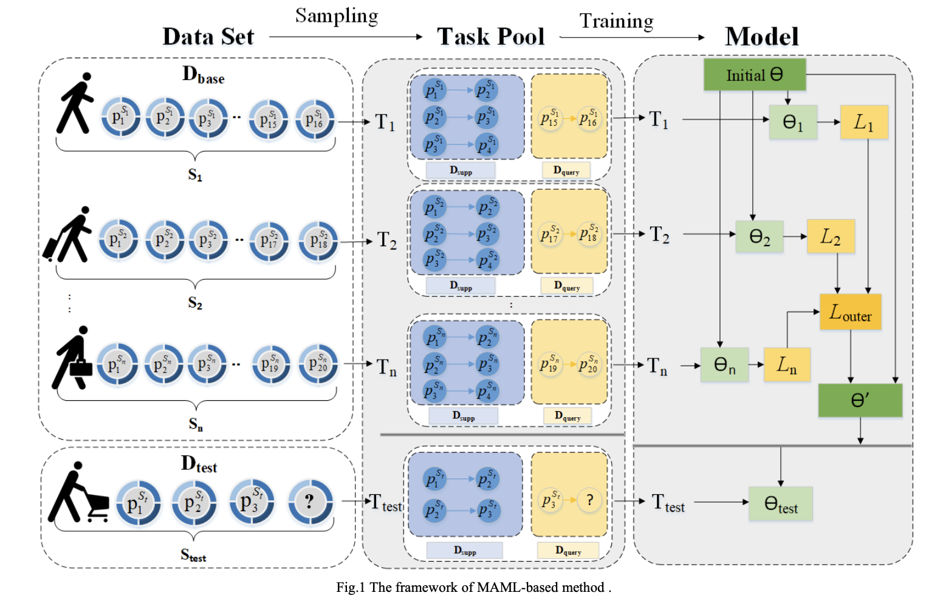

Slide 7
u_{m}: user ID
l_{i}: POI’s ID
t_{i}: time
concatenation
Notes:
concatenation

Slide 8
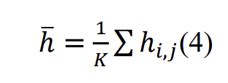
l_{k} =<id_{k} , lon_{k} , lat_{k}>
ID, longitude, latitude
Notes:
to measure the spatial-temporal transition information ℎ𝑖𝑖,𝑗𝑗 between two points.

Slide 9
Loss function

Slide 10
Outline
Introduction
Method
Experiment
Conclusion

Slide 11
Dataset
location-based social networking website where users share their locations by checking-in

Slide 12
 | time | spatial | Meta-learning
SASRec
GeoSAN | v | v
MetaTL |  |  | v
STMeta | v | v | v

Slide 13
Ablation Experiment
MAML
MAML+ temporal
MAML+ spatial

Slide 14
Outline
Introduction
Method
Experiment
Conclusion

Slide 15
Conclusion
proposes a next POI recommendation method for cold-start users by following the meta-learning method MAML
spatial and temporal information are helpful for the next POI recommendation

